Slide 1
IPL Schedule
A Java project on IPL Schedule , Teams and Venue details

Slide 2
Introduction
A java project to perform various operations on the IPL schedule
Features:
Print the full schedule
Search by team
Search by venue
Search by date

Slide 3
Data
We used Map Data Structure to store team and venue details
  Teams - Map<Integer, String>
  Venues - Msp<Integer, String>
We used List Data Structure to store the scheduling details
  Scheduling - List<Schedule>
public class Schedule { public int team1Id; public int team2Id; public Date date; public int venueId; }

Slide 4
Feature details
Search by Team:
  Input: Team Id
  Search algorithm: Linear search
  Output: Scheduled matches of the selected team
Search by Venue:
  Input: Venue Id
  Search algorithm: Linear search
  Output: Scheduled matches on the selected venue
Search by Date:
  Input: Date in dd/MM/yyyy format
  Search algorithm: Linear search
  Output: Scheduled matches on the selected date

Slide 5
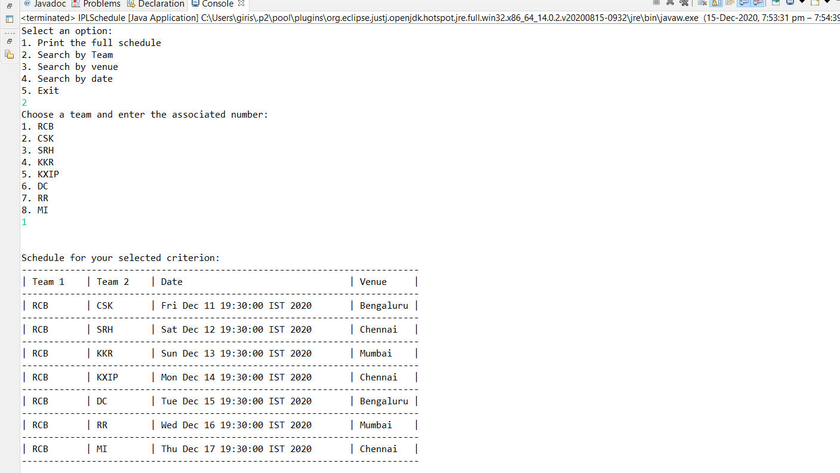
Search by team

Slide 6
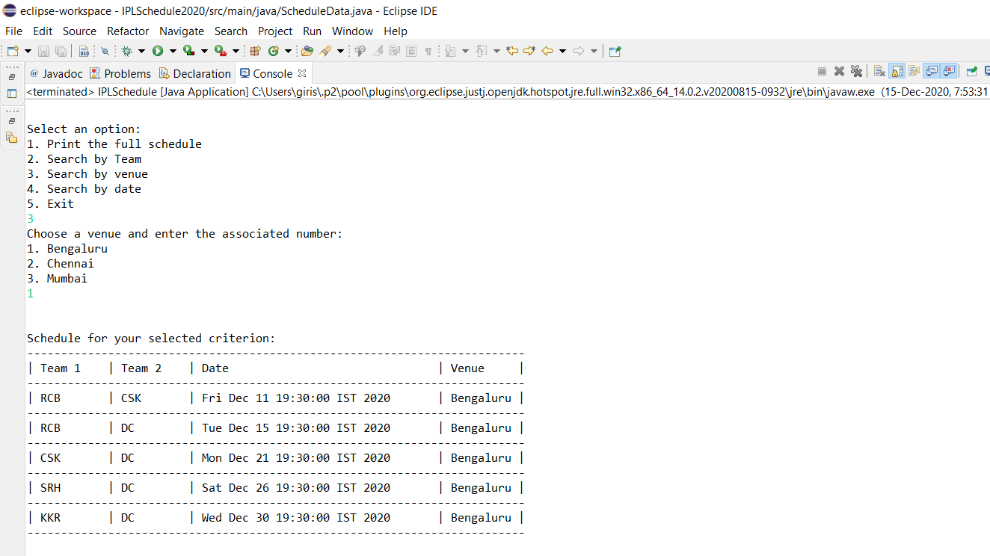
Search by venue

Slide 7
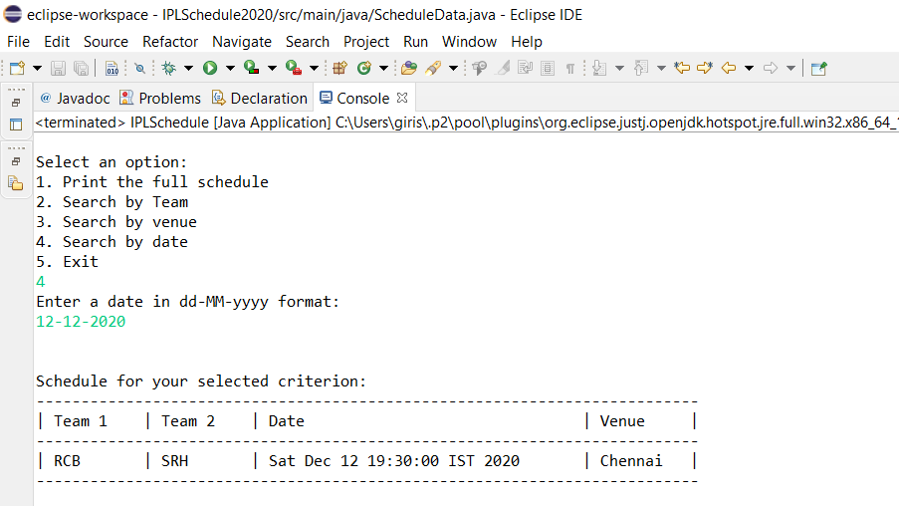
Search by date

